Slide 1
L1_Time complexity's complex examples

Slide 2

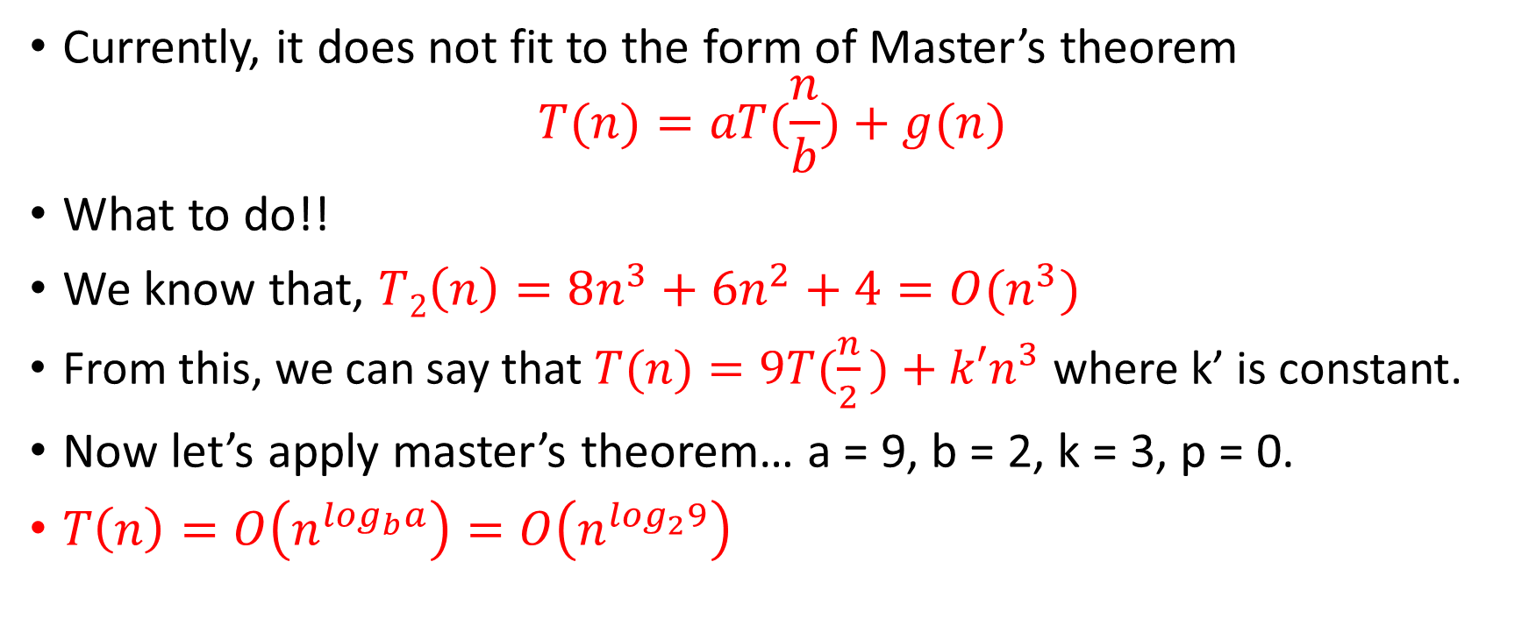

$$T(n)=9T(\frac{n}{2}​)+8n^{3}+6n^{2}+4$$
Currently, it does not fit to the form of Master’s theorem
$$T(n)=aT(\frac{n}{b})+g(n)$$
What to do!!
We know that, $T2\left(n\right)=8n^{3}+6n^{2}+4=O(n^{3})$
From this, we can say that $T(n)=9T(\frac{n}{2}​)+k′n^{3}$ where k’ is constant.
Now let’s apply master’s theorem… a = 9, b = 2, k = 3, p = 0.
$T\left(n\right)=O\left(n^{\log_{b}a}\right)=O\left(n^{\log_{2}9}\right)$

Slide 3
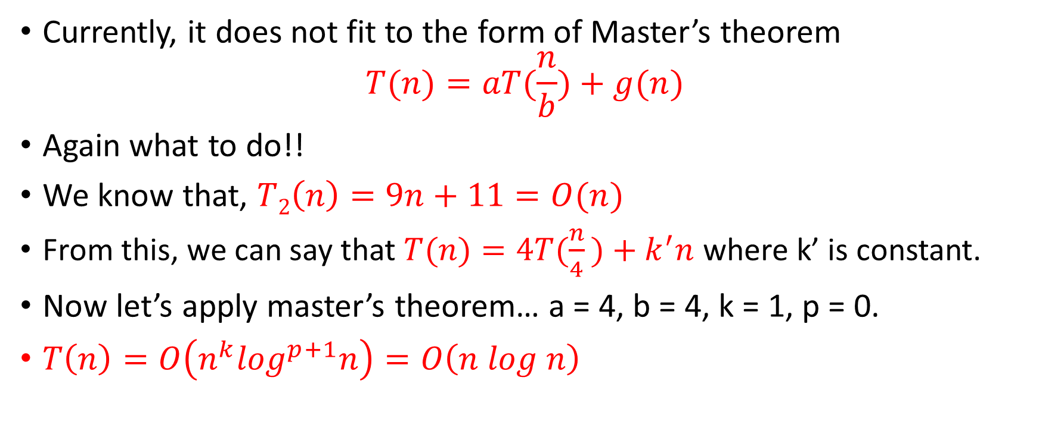

$$T(n)=4T(\frac{n}{4}​)+9n+11$$
Currently, it does not fit to the form of Master’s theorem
$$T(n)=aT(\frac{n}{b})+g(n)$$
Again what to do!!
We know that, $T2\left(n\right)=9n+11=O(n)$
From this, we can say that $T(n)=4T(\frac{n}{4}​)+k^{′}n$ where k’ is constant.
Now let’s apply master’s theorem… a = 4, b = 4, k = 1, p = 0.
$T\left(n\right)=O\left(n^{k}\log^{p+1}n\right)=O\left(n log n\right)$

Slide 4
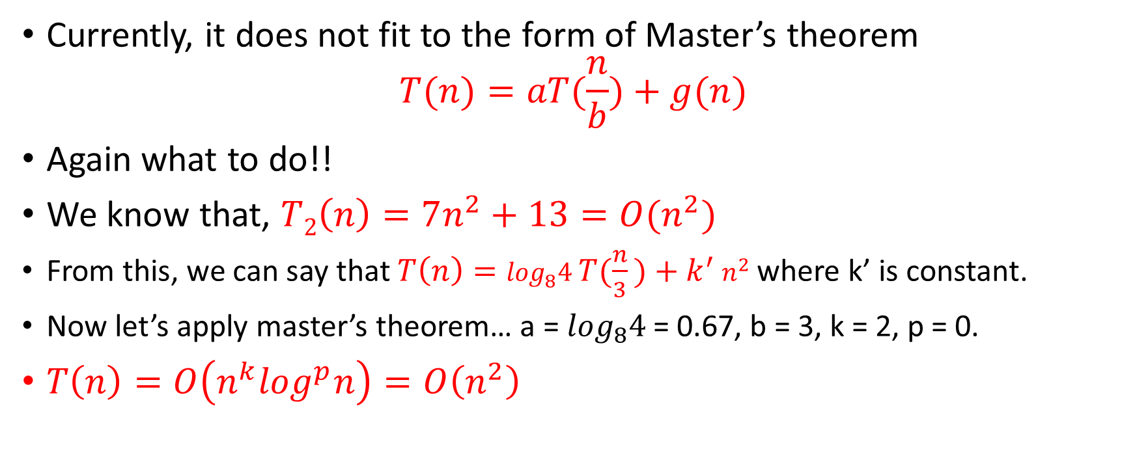

$$T\left(n\right)=\log_{8}4 T(\frac{n}{3}​)+7n^{2}+13$$
Currently, it does not fit to the form of Master’s theorem
$$T(n)=aT(\frac{n}{b})+g(n)$$
Again what to do!!
We know that, $T2\left(n\right)=7n^{2}+13=O(n^{2})$
From this, we can say that $T\left(n\right)=\log_{8}4 T(\frac{n}{3}​)+k^{′}$ $n^{2}$ where k’ is constant.
Now let’s apply master’s theorem… a = $\log_{8}4$ = 0.67, b = 3, k = 2, p = 0.
$T\left(n\right)=O\left(n^{k}\log^{p}n\right)=O\left(n^{2}\right)$

